Slide 1

Obesity Levels Analysis: Eating Habits and Physical Condition
This study examines obesity levels in Mexico, Peru and Colombia. It analyzes eating habits, physical condition and other factors affecting 2,111 individuals aged 14-61.
The dataset contains 17 attributes to classify obesity levels from insufficient weight to obesity type III.

Slide 2
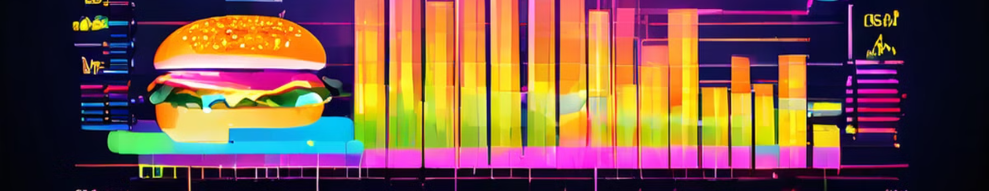
Dataset Overview
1
Sample Size
2
Attributes
3
Classification
2,111 participants aged 14-61 from Mexico, Peru and Colombia surveyed.
17 total: 8 numerical and 9 categorical variables related to diet and lifestyle.
Obesity levels range from insufficient weight to obesity type III.

Slide 3
Research Objectives
Analyze Obesity Trends
Identify Risk Factors
Improve Public Health
Identify key lifestyle factors linked to obesity and forecast future trends
Analyze eating habits and physical conditions contributing to obesity development.
Address obesity-related cardiovascular diseases in developing nations through data-driven interventions.

Slide 4
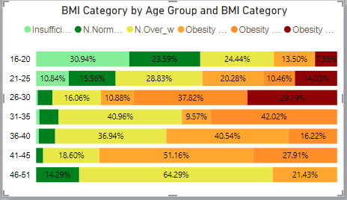
Age and Obesity Correlation
1
Young Adults (16-25)
Higher percentage of normal weight and underweight individuals compared to older groups.
2
Adults (26-30)
Highest percentage of individuals in Obesity II and III categories.
3
Middle-Aged (46-51)
Largest proportion of individuals in the overweight category.

Slide 5
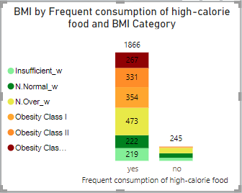
High-Calorie Food Consumption Impact
High-Calorie Food Consumption: Individuals who frequently
consume high-calorie foods are more likely to be in higher obesity
categories:
Obesity Class I: 473 individuals
Obesity Class II: 222 individuals
Obesity Class III: 267 individuals
Normal Weight: Only 331 individuals
· Low-Calorie Food Consumption: Individuals who do not frequently
consume high-calorie foods have a more balanced distribution across BMI
categories, with 245 individuals spread out among different categories.
· Conclusion: There is a strong link between high-calorie diets and obesity,
while Healthier dietary habits have a significant impact on maintaining a
balanced BMI.

Slide 6
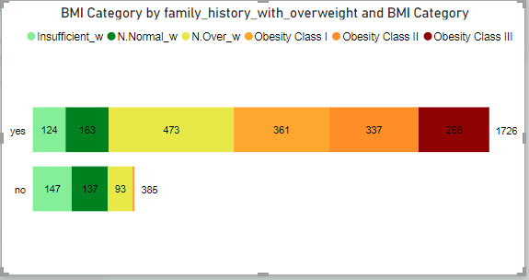



Family History and Obesity Risk
Family History Present
1,726 individuals in obesity categories, with 268 in Class III.
No Family History
Fewer cases in obesity categories, but 385 still in higher BMI ranges.
Conclusion
Family history significantly influences obesity risk, impacting weight management strategies.

Slide 7

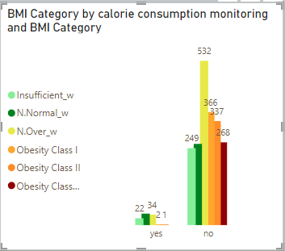


Calorie Monitoring and BMI
No Monitoring
Largest group in Obesity Class I (532). Second largest in Normal Weight (366).
Calorie Monitoring
Largest group in Normal Weight (374). Fewer cases in higher BMI categories.
Conclusion
Calorie monitoring associated with healthier weight ranges. Potential tool for weight management.

Slide 8
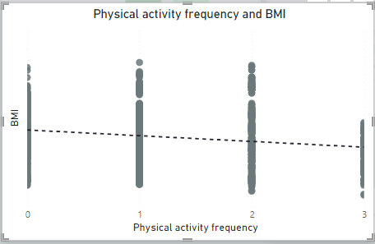
Physical Activity and BMI Correlation
Negative Correlation
Wide Distribution
Slight downward trend indicates BMI tends to decrease as physical activity increases.
Many individuals across activity levels fall within a broad BMI range.
Multifactorial Influence
Physical activity impacts BMI, but other factors likely play significant roles too.

Slide 9
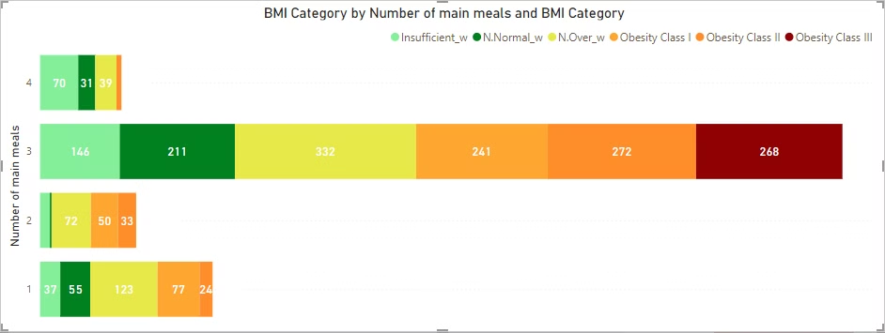
Meal Frequency and Weight Distribution
More Frequent Meals
Three Meals
Fewer Meals
Associated with normal weight range. Four meals a day show fewer individuals in higher obesity categories.
Broader distribution across weight categories. Largest group in normal weight range, significant presence in obesity classes.
Two meals: many in normal range, noticeable numbers in overweight and obesity. One meal: balanced distribution across categories.

Slide 10
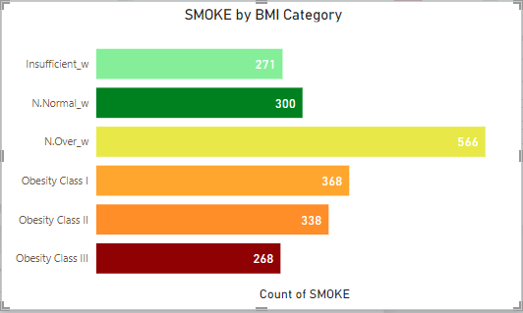
Smoking and Weight Categories
1
Overweight Prevalence
2
Distribution Across Categories
Most smokers fall in the Overweight category, with a significant number in Obesity Class I.
Notable portions of smokers found in Normal weight and Insufficient weight groups.
3
Severe Obesity Correlation
Fewer smokers observed in Obesity Class II and III categories.

Slide 11
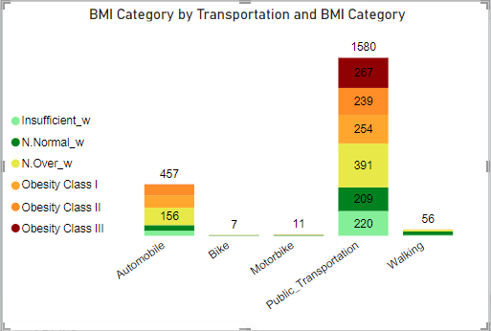
Transportation Mode and Weight Categories
1
Public Transportation
Users spread across all weight categories, with significant numbers in Obesity Class I and III.
2
Automobile
Users primarily found in Normal weight and Overweight groups.
3
Walking
Associated with a higher number of individuals in the Normal weight category.
4
Biking and Motorbiking
Few users, mostly within the Normal weight range.

Slide 12

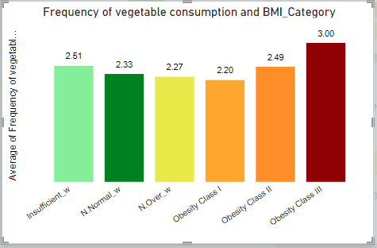


Vegetable Consumption and Obesity Levels
Early Intervention
Promote consistent vegetable consumption in "Normal Weight" and "Overweight" stages to prevent obesity progression.
Timing of Dietary Changes
Increase in vegetable intake in severe obesity suggests dietary changes often occur too late.
Preventative Education
Early education on healthy diets is essential to prevent reaching severe obesity stages.

Slide 13
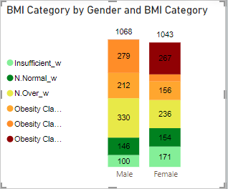
Gender-Specific Weight Distribution
Gender
Key Observations
Recommendations
Males
Higher representation in obesity categories
Targeted obesity-reduction interventions
Females
Concerns in both insufficient weight and obesity
Address underweight and overweight issues

Slide 14
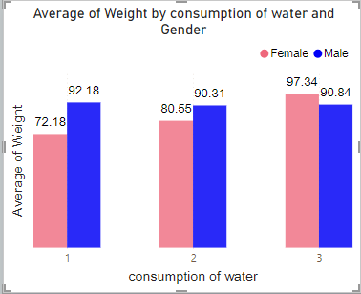
Water Consumption and Weight Correlation by Gender
Females
Males
Higher water consumption linked to increased weight. Hydration strategies should align with diet management.
Weight remains stable despite water intake variations. General hydration promotion without weight fluctuation concern.
Overall
Both genders need education on hydration importance combined with a balanced diet.

Slide 15
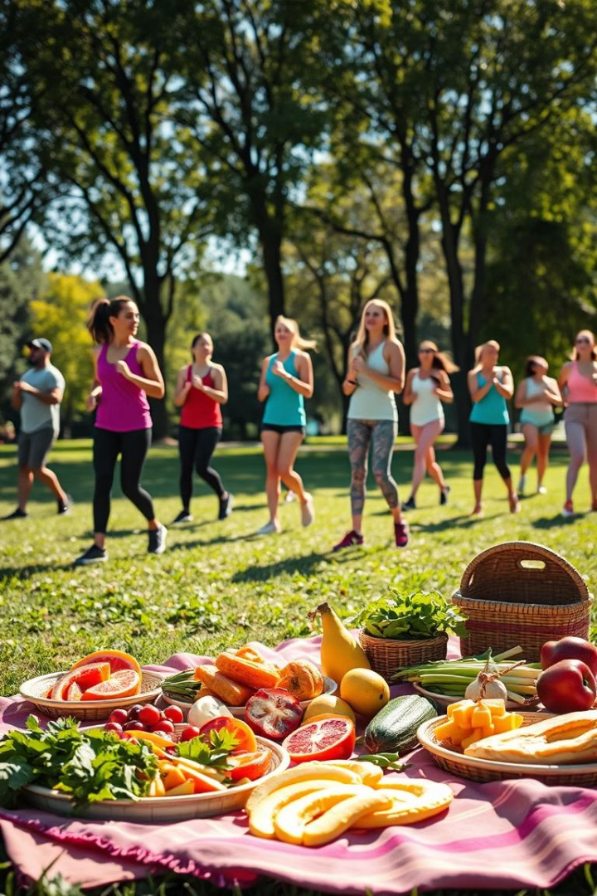



Empowering Health: Final Recommendations on Obesity
Calorie Monitoring
Essential for maintaining healthy BMI, especially for those with family history of obesity.
Targeted Programs
Age-specific interventions for diet, exercise, and health awareness.
Active Transport
Encourage walking and biking; improve urban walkability for healthier communities.

Slide 16
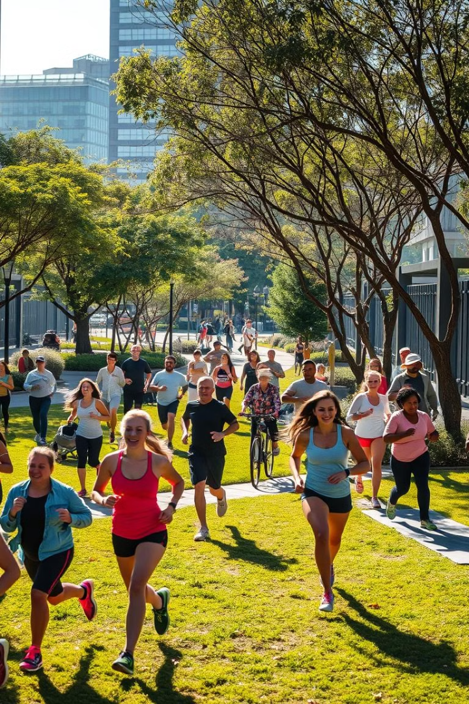
Final Conclusion
1
Targeted Approach
2
Early Prevention
Focus on calorie awareness, physical activity, and balanced diets for different age groups.
Implement programs for young people to reduce long-term health risks.
3
Community Strategies
Improve walkability and promote active transportation to support healthier lifestyles for everyone.

Slide 17

Thank You !

